Slide 1

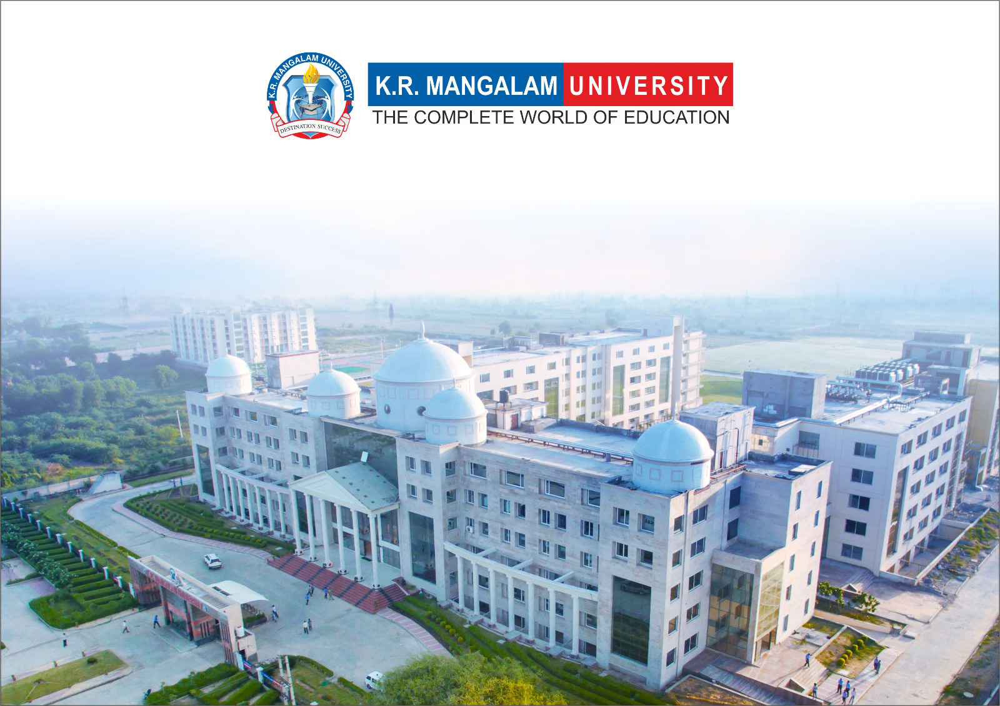
Introduction to Water Chemistry & Hardness
Course Code: ETMLCH104
Course Name: Engineering Chemistry
Program: B.Tech. (AI/ML)
Unit1:Water technology & Chemical Fuels
Dr Pratibha Sharma
Assistant Professor, Department of Chemistry
School of Basic and Applied Sciences
K.R. Mangalam University
Sohna Road, Gurugram

Slide 2

Course Overview
Unit Number: 1 | Title: Water technology | No. of hours: 6
Introduction, water analysis: Hardness-determination by EDTA method, Treatment of boiler feed water: Internal treatment (Phosphate, Colloidal and Calgon conditioning). External treatments: Ion exchange and lime-soda process, Zeolite processes. Boiler scales formation and ill effects, methods of prevention of scales. Numerical problems
Unit Number: 2 | Title: Chemical Fuels | No. of hours: 9
Fuels: Introduction, classification, calorific value (HCV & LCV), Determination of calorific value of fuel using Bomb calorimeter. Solid fuel: Coal- its analysis by proximate and ultimate analysis, Numerical problems. Liquid fuels: Refining of petroleum, Petroleum cracking, Knocking in IC engine, its ill effects and prevention of knocking. Anti-knocking agent: Leaded and unleaded petrol. Gaseous fuels: LPG, CNG and their applications.
Unit Number: 3 | Title: Battery Technology | No. of hours: 10
Introduction - Galvanic cell, electrode potential, EMF of the cell and cell representation. Batteries and their importance, Classification of batteries- primary, secondary and reserve batteries with examples. Battery characteristics - voltage, capacity, energy density, power density, energy efficiency, cycle life and shelf life. Construction, working and applications of: Ni-Cd, and Lithium-ion battery. Working principle of an electric vehicle.
Unit Number: 4 | Title: Polymer | No. of hours: 5
Basic concepts of polymer, Types of polymers, Thermoplastic & thermosetting plastics, Preparation and application of some industrially important polymers (Natural rubber, Buna S, Buna-N, Neoprene, Isoprene, Nylon-6, nylon-6,6 , Decron and Terylene). Conducting and biodegradable polymers.

Slide 3
COURSE OUTCOMES
CO1: Understand the methods for water hardness and the basics of boiler water treatment and analyze fuel calorific values and battery.
CO2: Explain the characteristics and working principles of different battery types and types of fuels.
CO3: Determine the differences between batteries and fuel cells and classify fuel cell types based on their components..
CO4: Identify between hard and soft water, solve the related numerical problems on water purification and emf and its significance in industry and daily life.

Slide 4
Boiler Scale Effects and Prevention Methods
Boiler troubles: Scale, Sludge, Priming & Foaming, Caustic Embrittlement

Slide 5
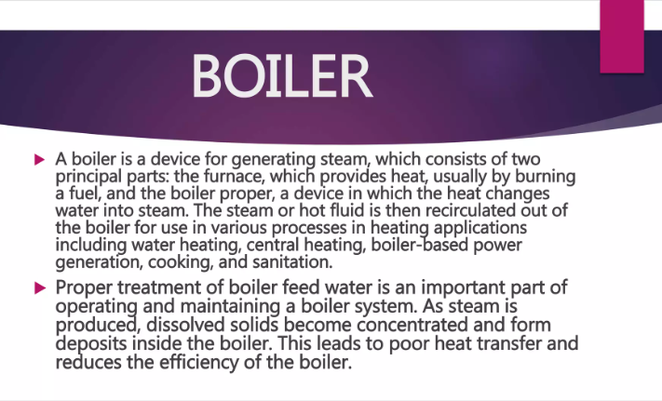

Slide 6
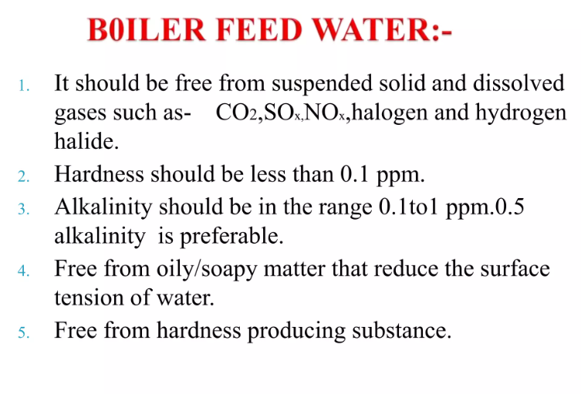

Slide 7
Introduction to Boiler Feed Water Issues
Boiler feed water must be free from impurities for efficient and safe operation.
Common impurities cause several operational problems such as:
→ Scale formation
→ Sludge deposition
→ Priming and foaming
→ Caustic embrittlement
→Boiler Corrosion

Slide 8
Scale Formation
Definition:
Scale is a hard, adherent deposit that forms on the inner surfaces of boiler.
It consists mainly of calcium and magnesium salts.
Causes:
Decomposition of bicarbonates, Ca²⁺/Mg²⁺ salts.
Ca(HCO₃)₂ → CaCO₃↓ + H₂O + CO₂↑
Presence of sulfates and silicates of Ca²⁺ and Mg²⁺
Poor water treatment before feeding to boiler

Slide 9
Scale Formation
Disadvantages:
→ Poor heat transfer efficiency
→ Risk of metal overheating and bursting
→ Increased fuel consumption
Prevention:
→ Proper external water softening
→ Blow-down operations to remove deposits

Slide 10
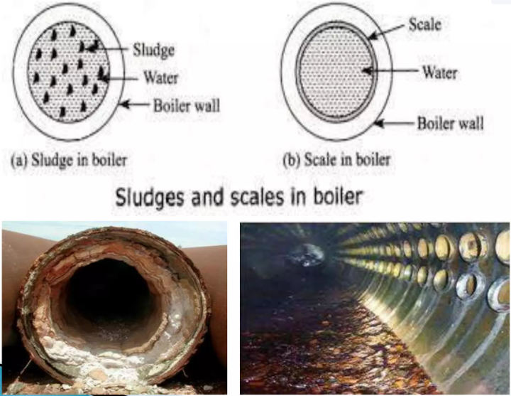

Slide 11
Sludge Formation
Definition:
Sludge is a soft, loose, non-adherent precipitate.
It usually forms in cooler parts of boiler like bends or joints.
Mainly consists of MgCl₂, MgCO₃, and other salts.
Causes: Salts like MgCl₂, MgCO₃.

Slide 12
Sludge Formation
Disadvantages:
→ Obstruction of water flow
→ Decrease in boiler efficiency
→ Local overheating and metal damage
Prevention:
→ Blow-down operation
→ Use of coagulants to aggregate particles

Slide 13
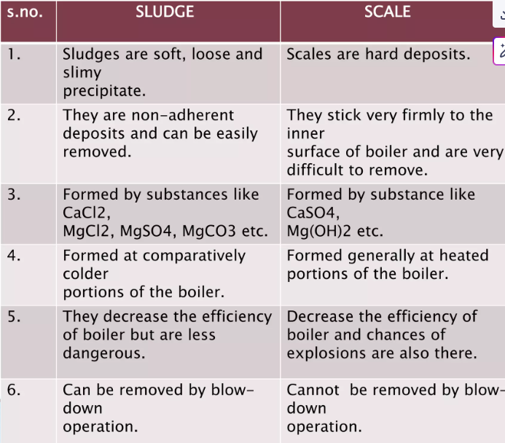

Slide 14
Priming and Foaming
Priming: Carryover of water droplets with steam.
Causes : → High water level in boiler
→ Sudden boiling or rapid steam production
→ Impurities increasing surface tension
Foaming: formation of stable bubbles in boiler water.
Causes: → Presence of oils, greases, and organic matter
→ High concentration of alkalinity in water

Slide 15
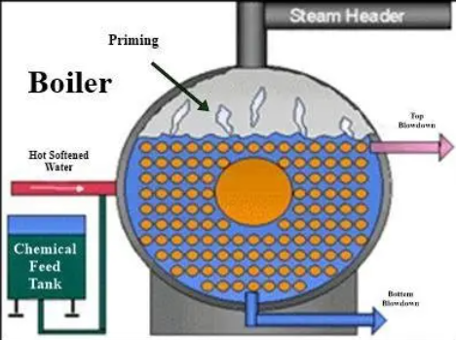

Slide 16
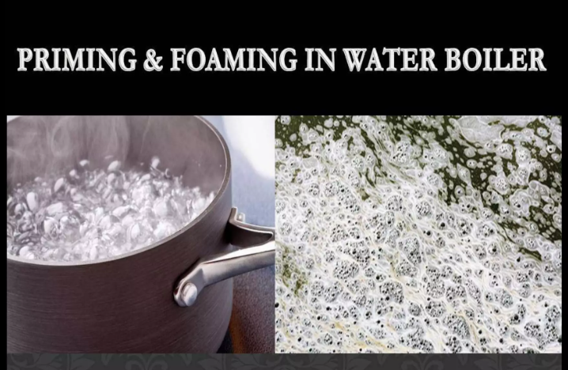

Slide 17
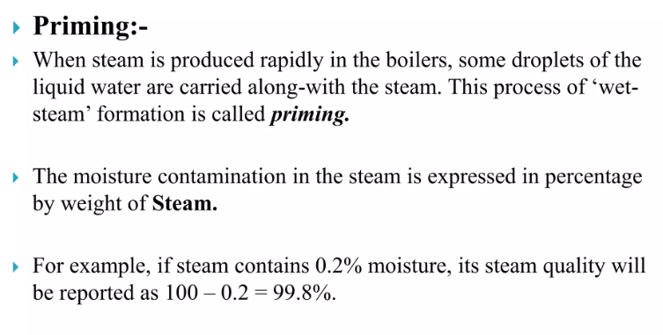

Slide 18
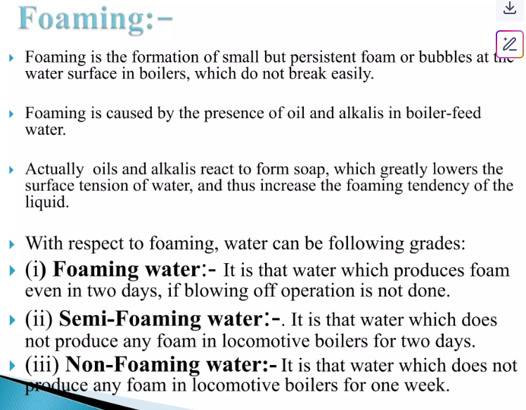

Slide 19
Priming and Foaming
Priming Effects:
→ Wet steam leading to mechanical damage in turbine
→ Carryover of dissolved solids and salts
Priming Prevention:
→ Maintaining proper water level
→ Controlling steam velocity
→ Use of steam separators

Slide 20
Priming and Foaming
Foaming Effects:
→ Steam contamination
→ Poor heat transfer
→ Priming
Foaming Prevention:
→ Avoid oils and organic matter in feed water
→ Use of anti-foaming agents like castor oil

Slide 21
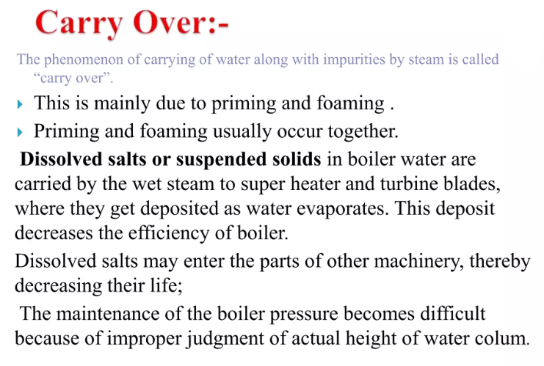

Slide 22
Caustic Embrittlement
Definition:
It is a localized corrosion at stress points in boiler.
Makes the boiler metal brittle and leads to cracking.
Occurs in high-pressure boilers.
Mechanism:
Na₂CO₃ → NaOH in high-pressure boilers.
Na₂CO₃ used in softening decomposes to form NaOH:
Na₂CO₃ + H₂O → 2NaOH + CO₂
NaOH seeps into crevices under high pressure and causes corrosion.

Slide 23
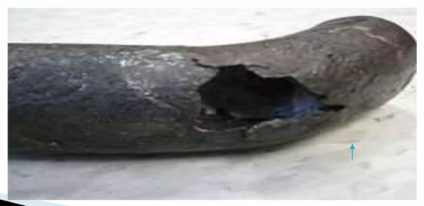
Caustic Embrittlement

Slide 24
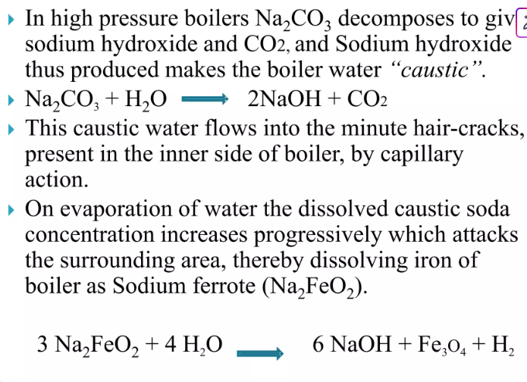
Caustic Embrittlement

Slide 25
Caustic Embrittlement
Disadvantages: OH⁻ attacks boiler metal at stressed points.
Prevention:
→ Avoid using Na₂CO₃ as softener in high-pressure boilers.
→ Use phosphate conditioning instead.
→ Add tannins/lignin to block stress points.
→ Proper design to avoid crevices and riveted joints.

Slide 26
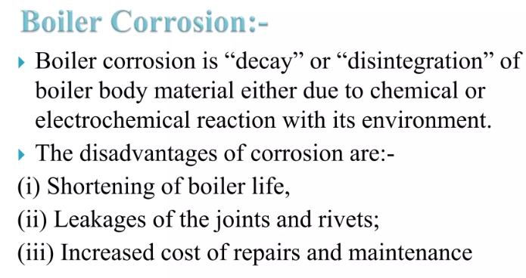
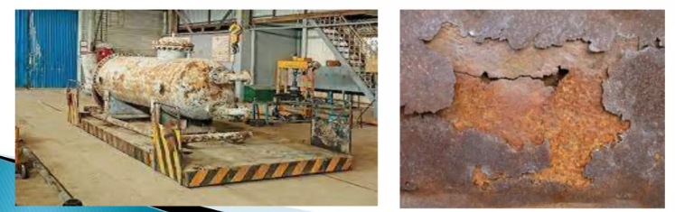

Slide 27
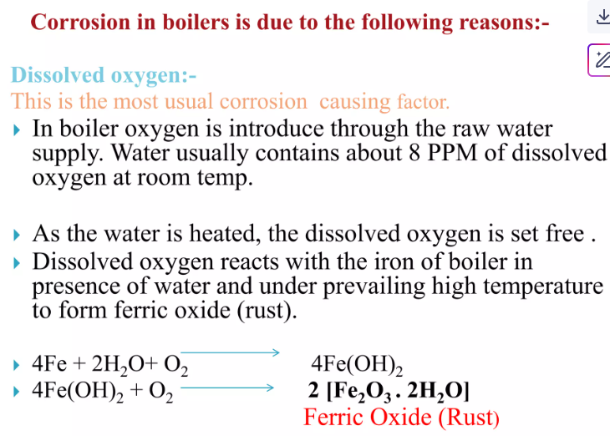

Slide 28
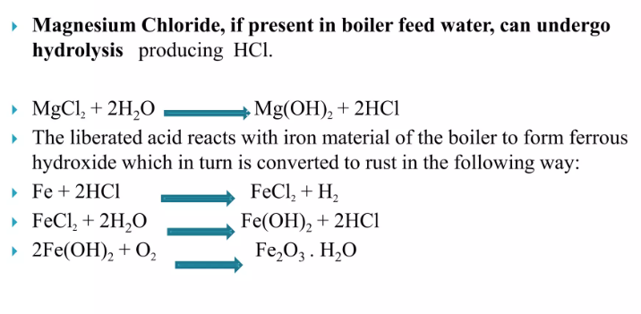
B) Mineral acid

Slide 29
Summary
Scale and sludge reduce efficiency, cause damage.
Priming and foaming lead to corrosion.
Caustic embrittlement weakens boiler metal.
Proper water treatment and maintenance are essential.

Slide 30
Take Away of The Session
Understand boiler water problems and their causes.
Apply preventive techniques in industrial context.
Ensure safe and efficient boiler operation.

Slide 31
MCQ Questions
1. What is the main cause of scale formation in boilers? a) NaCl b) Bicarbonate decomposition c) Silica d) High temp
2. What prevents foaming in boilers? a) NaCl b) Castor oil c) Lime d) Soda ash
3. Where does sludge typically form? a) Hot region b) Firebox c) Cool region d) Outlet
4. Caustic embrittlement is caused by? a) CaCO₃ b) NaOH c) MgCl₂ d) HCl
5. How to prevent caustic embrittlement? a) Use Na₂CO₃ b) Raise pressure c) Phosphate conditioning d) Add MgCl₂

Slide 32
References
Engineering Chemistry by Jain and Jain.

